Slide 1
Economics & Politics EQ: How do money, power, and politics impact our economy? D.12.03 D.12.06 D.12.12
Two Peas
in a Pod

Slide 2
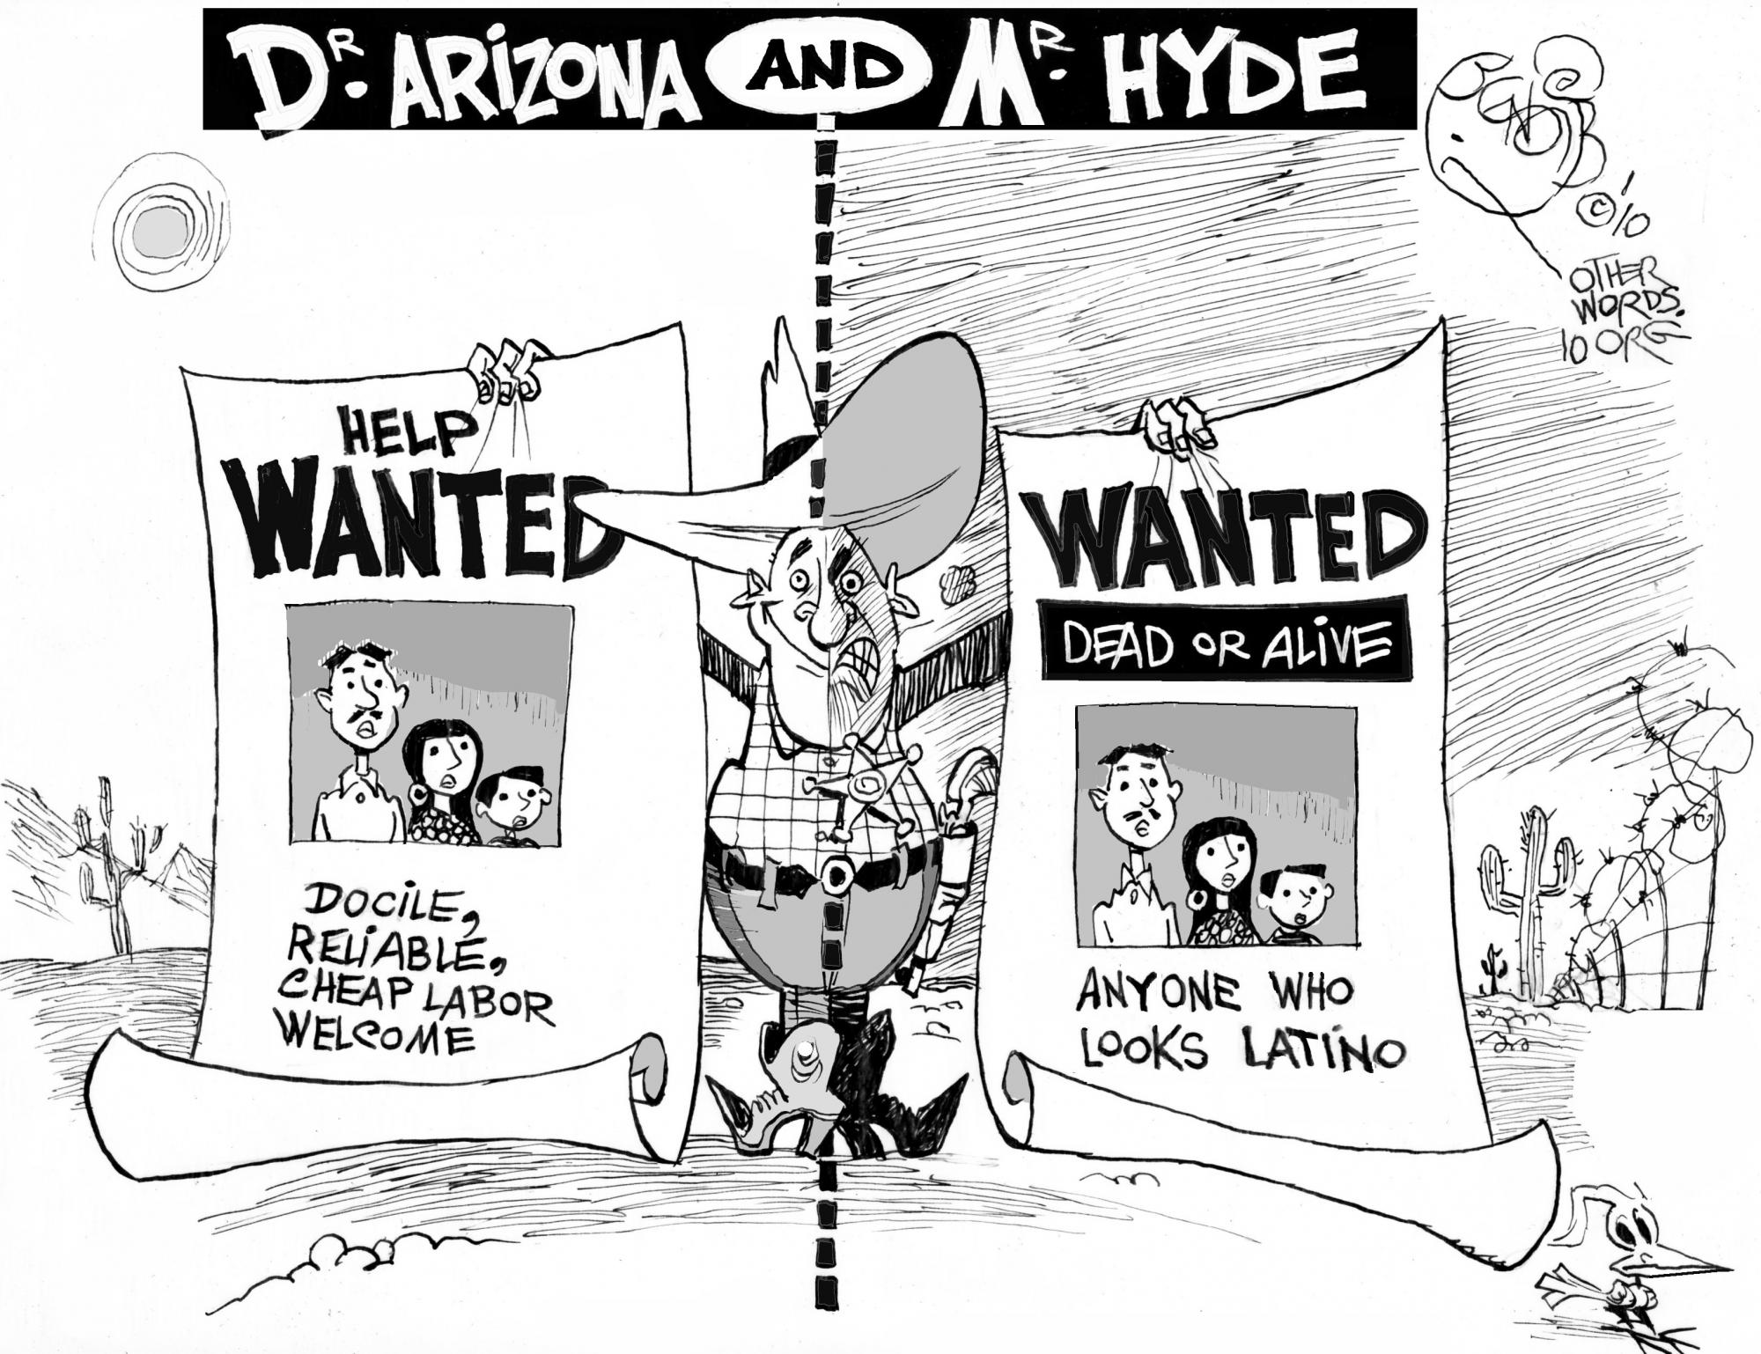
Background
Social Studies Includes:
Economics
Political Sci.
as well as…
History
Geography
Behavioral
Sciences
Notes:
ASK MR McGRATH

Slide 3
Topic 1: Elections, money, and power
“The economy, stupid!”
- James Carville
Bill Clinton’s 1992 Presidential campaign
Notes:
I can find a current chart for voter concerns. Is this set of slides what you would have used for the 2-class lesson?

Slide 4
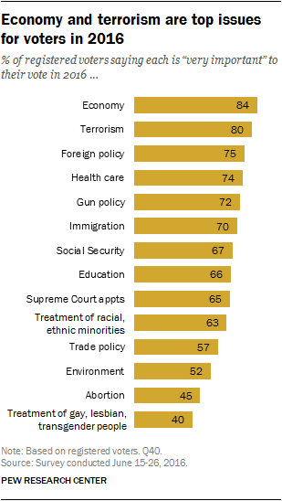
“The Economy, stupid!” -James Carville 1992 campaign
American voters consistently name the economy as their most pressing issue
Notes:
I can find a current chart for voter concerns. Is this set of slides what you would have used for the 2-class lesson?

Slide 5
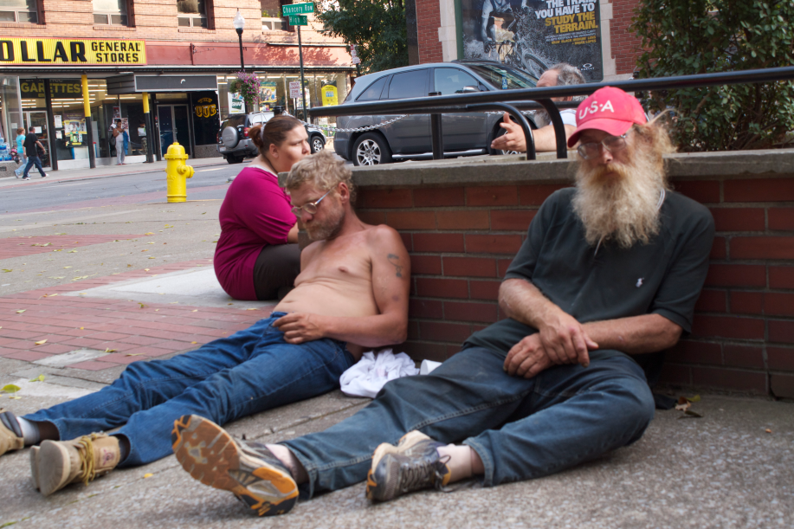
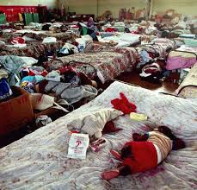
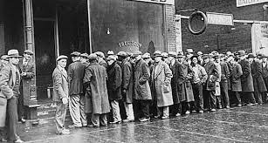
Images of a Bad economy
Notes:
ASK ABOUT THESE or update

Slide 6
Who are voters?
Politicians are always running for re-election
They need to appeal to the voters
Appeal to the likeliest voters
In the U.S., that’s seniors
Notes:
I can look for through 2016, but it will look the same. Try Southern Poverty Law Center or Pew.

Slide 7
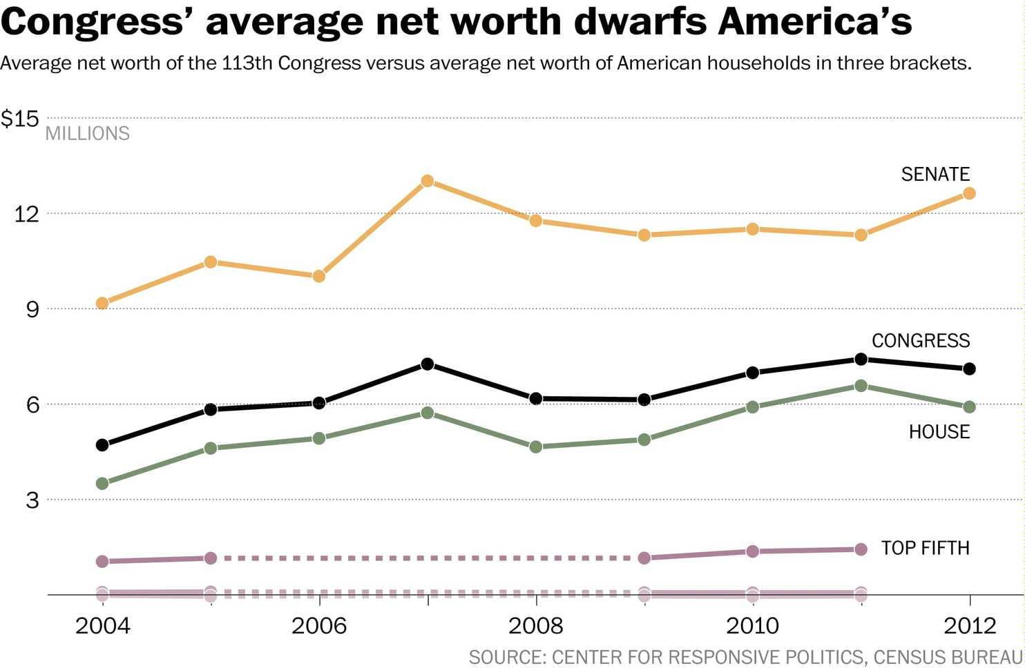
Money = Power
There is a strong association between money and power in the U.S.
The average member
of Congress has a lot more money than the average American

Slide 8
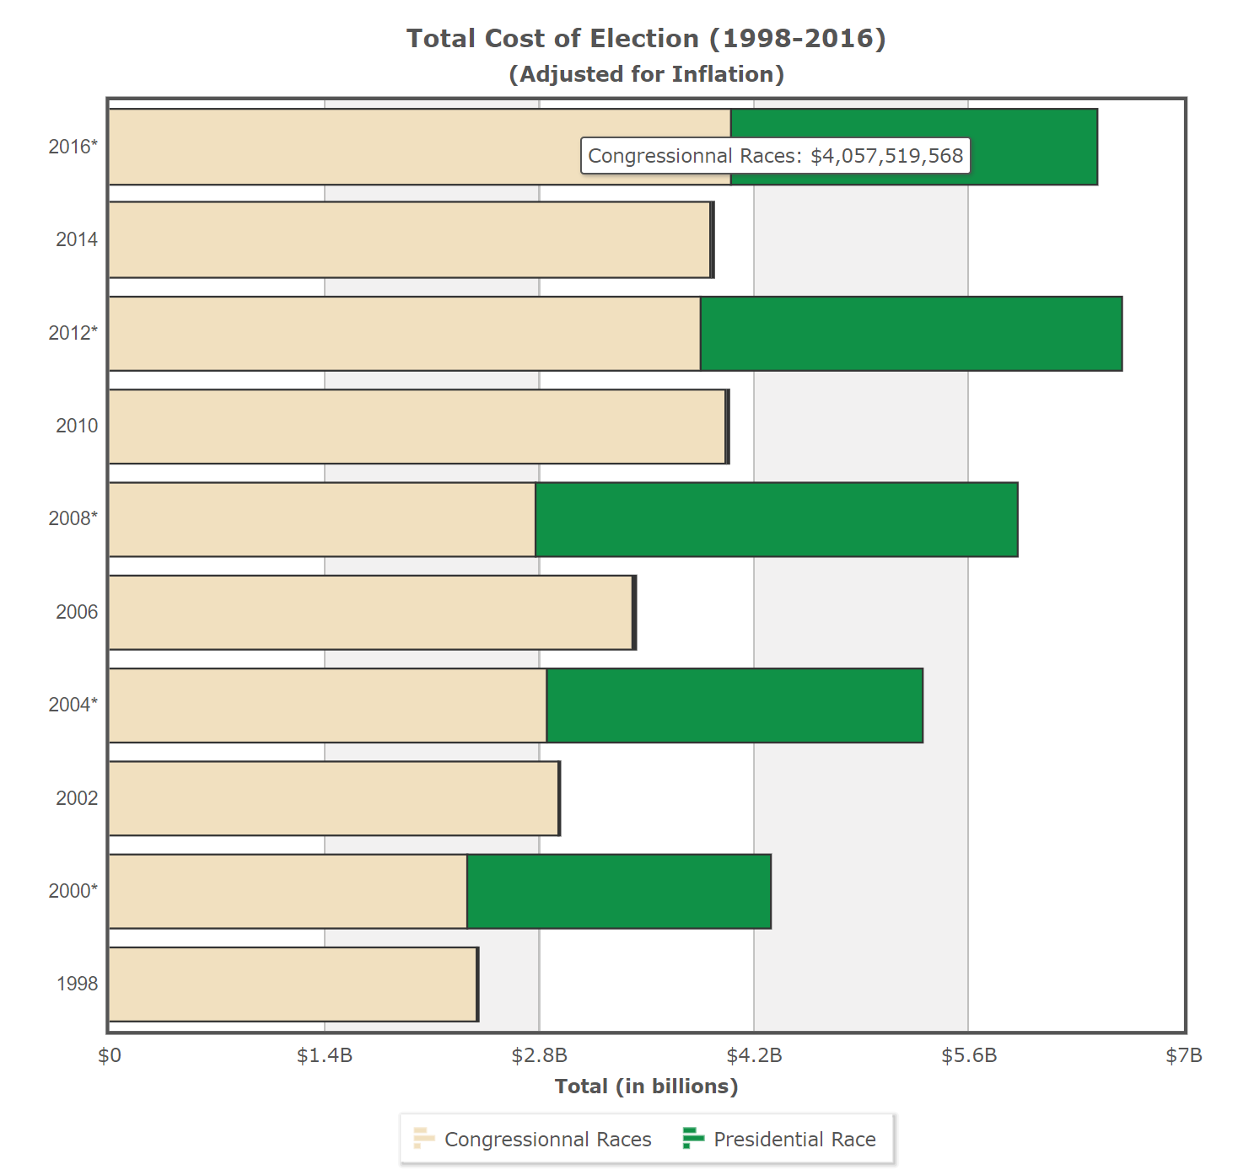
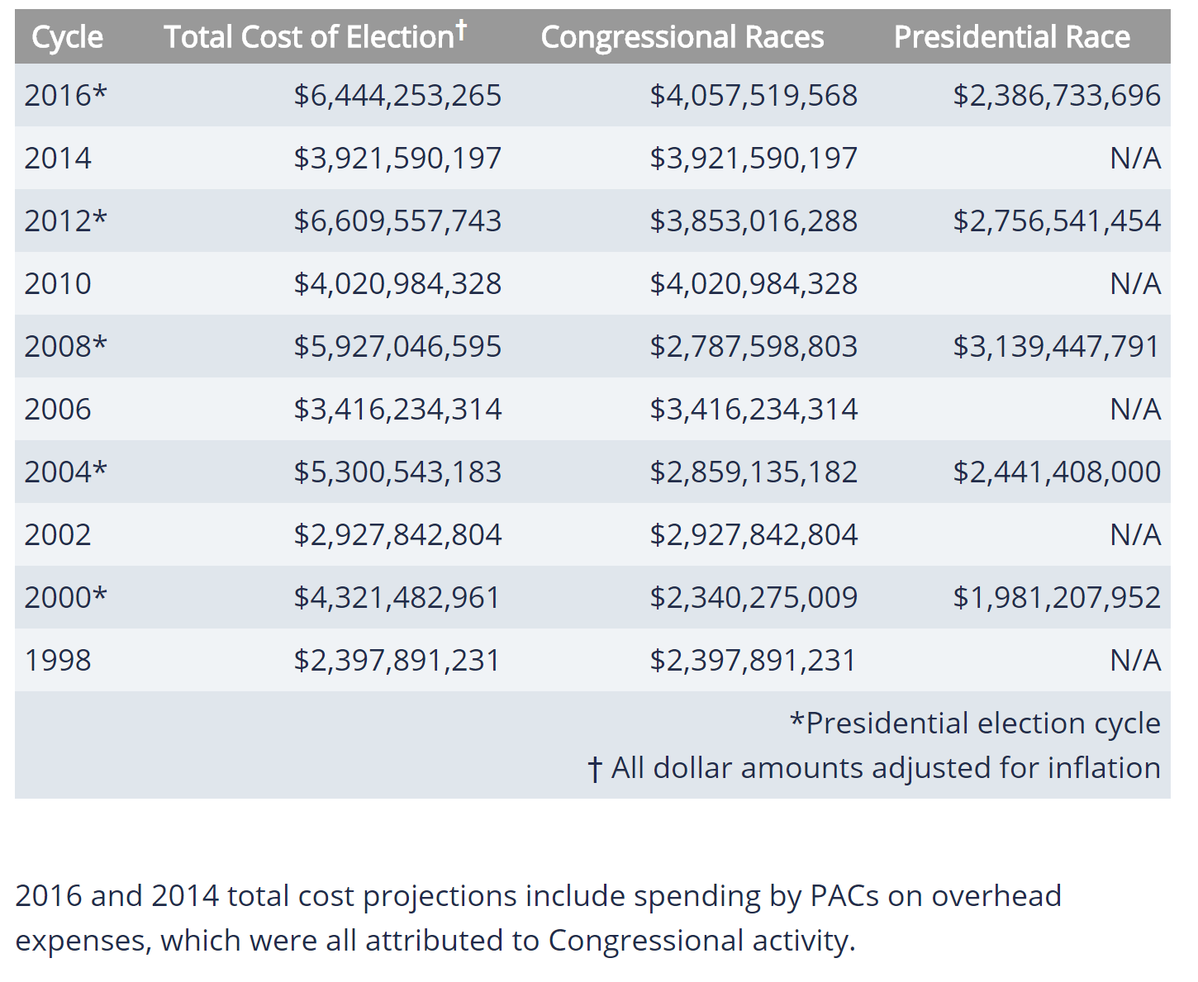
the economics of u.S. politics
The cost of elections continues to reach staggering dollars

Slide 9
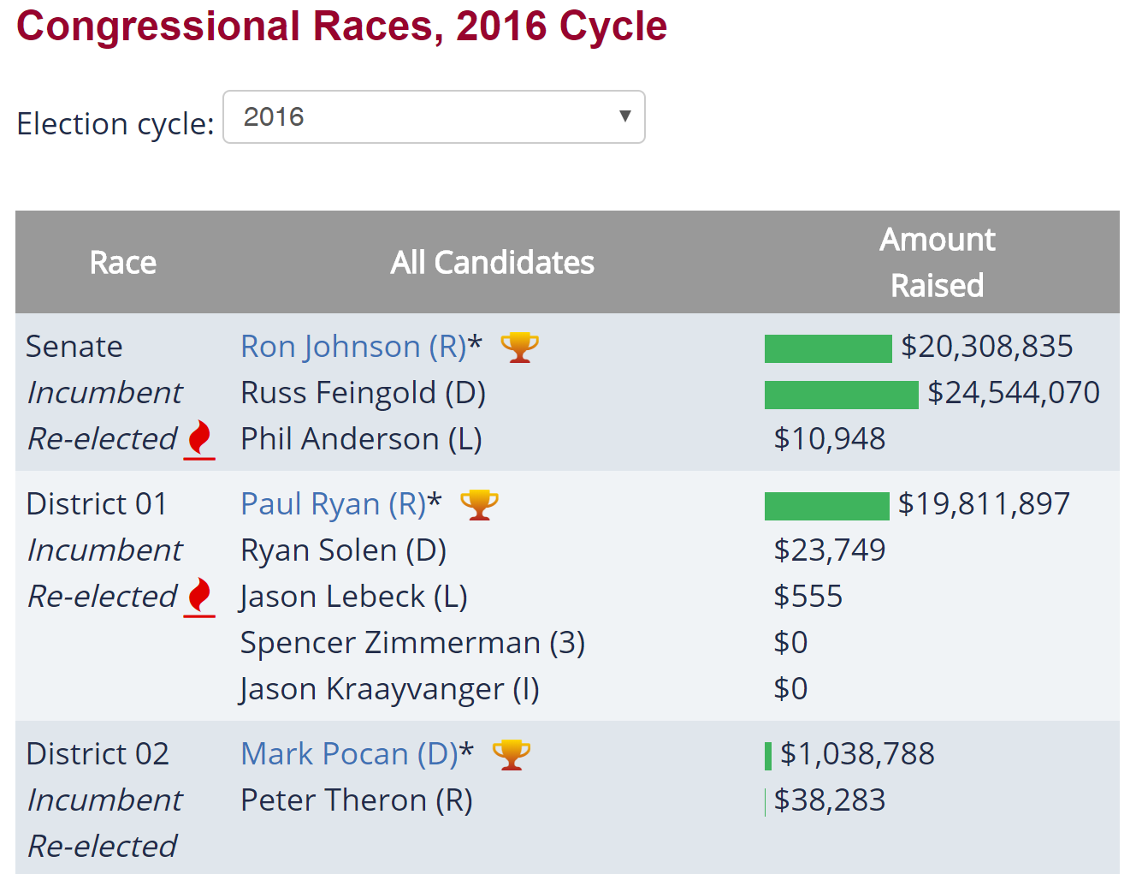
the economics of congressional politics in Wisconsin

Slide 10
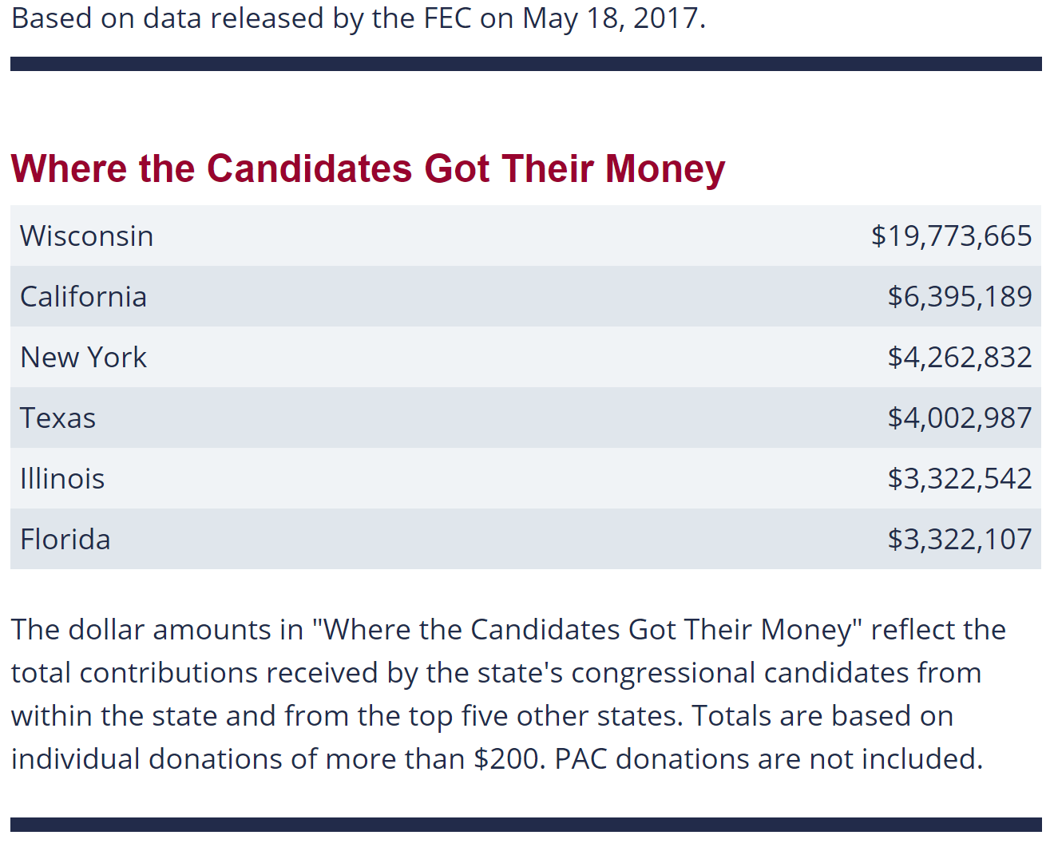
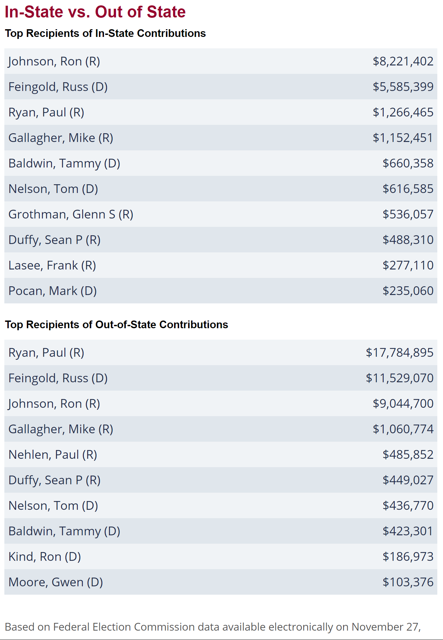
the economics of congressional politics in Wisconsin

Slide 11
the economics of Gubernatorial politics in Wisconsin
2014 Wisconsin Governor's Race

Slide 12
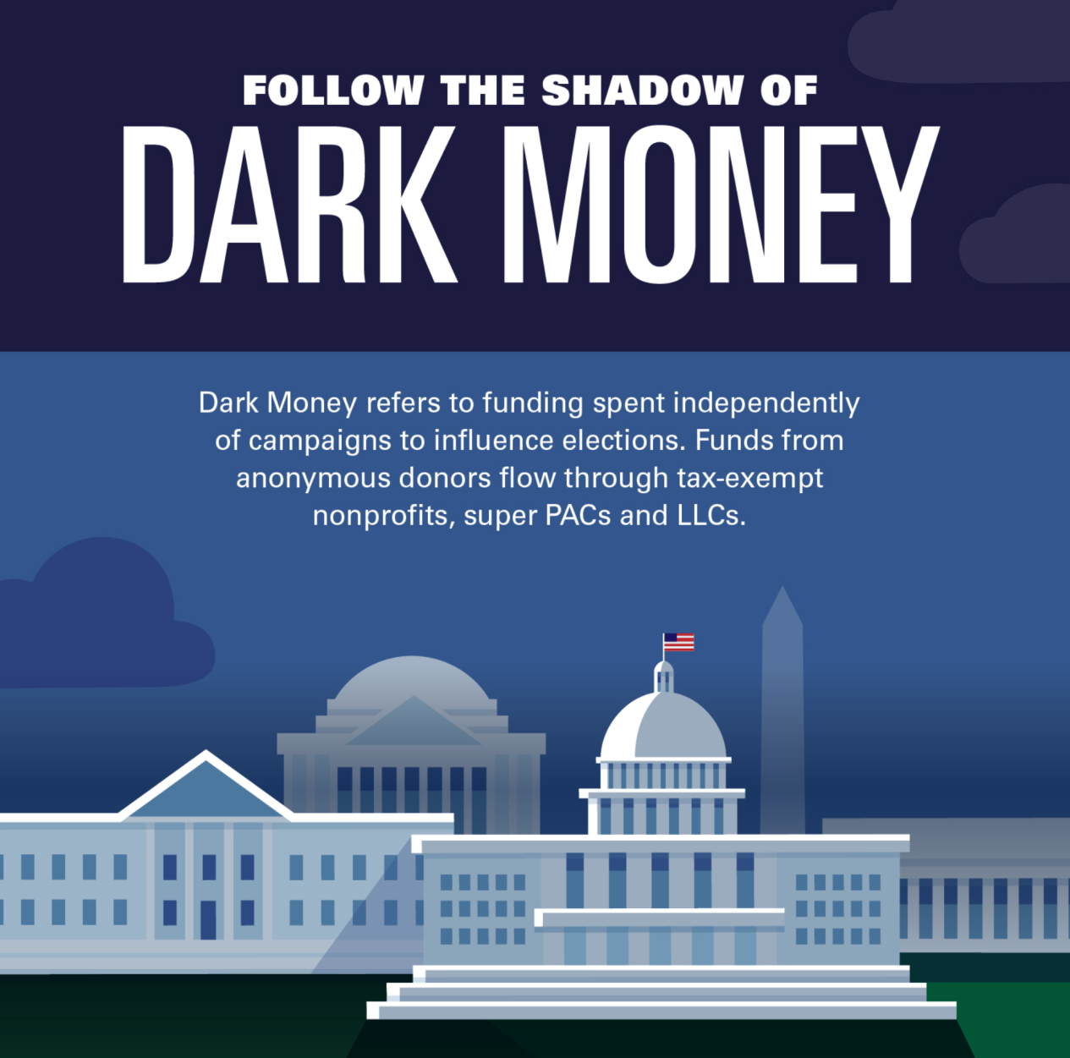
Where’s all this extra money coming from?

Slide 13
More dark money spending

Slide 14
10x more dark money spending!

Slide 15
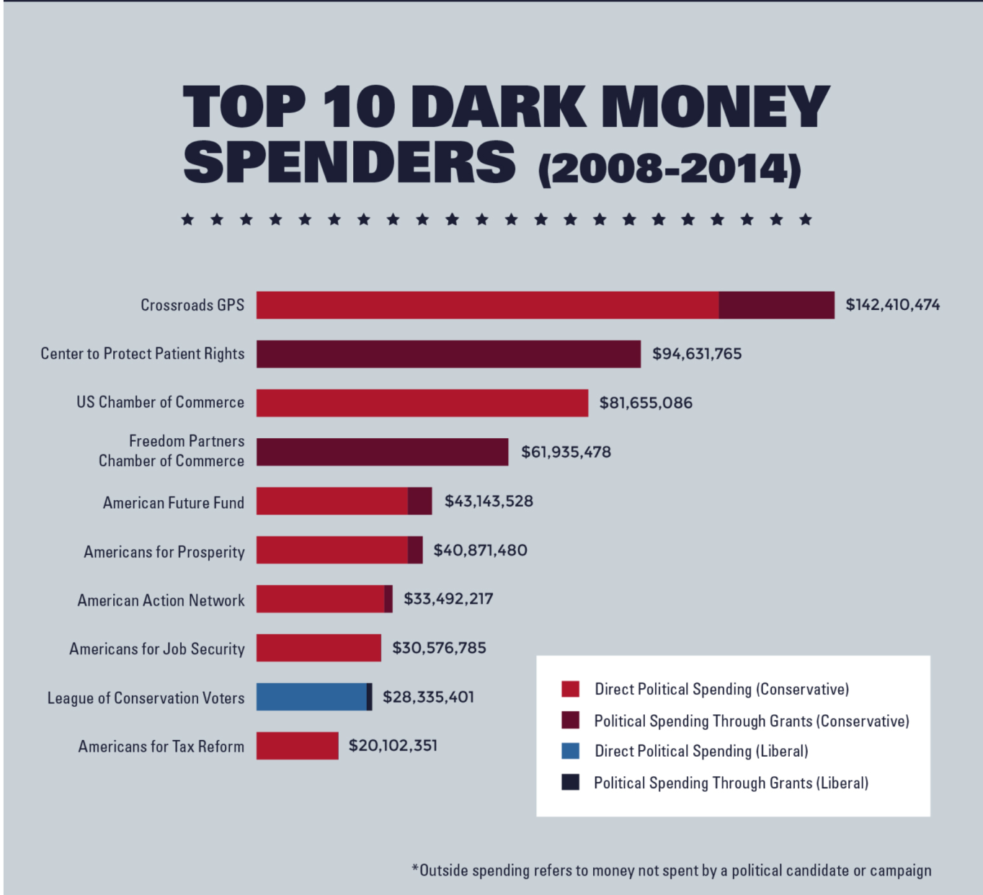
Who’s providing all this money?

Slide 16
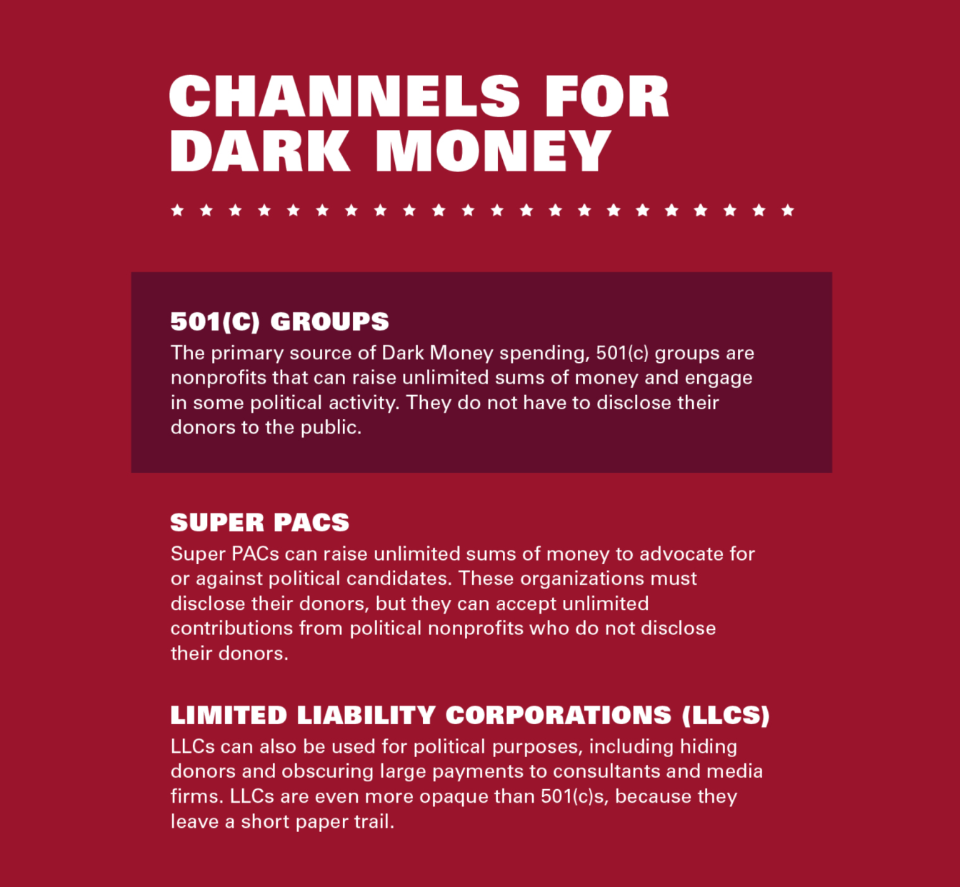
How does dark money get into the campaign?

Slide 17
That’s a lot of $$$

Slide 18
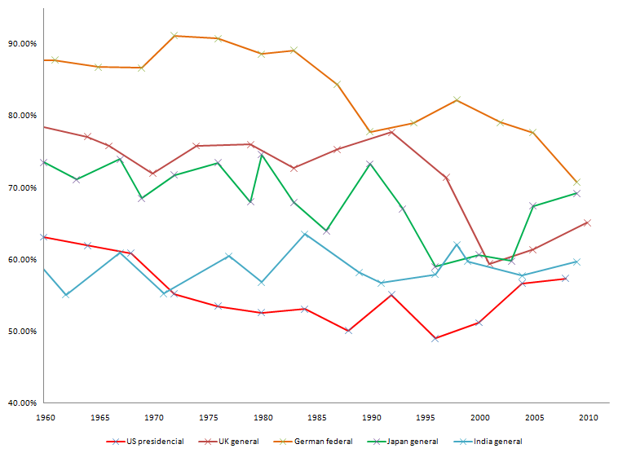
U.S. ranks 31 out of 35 in % of eligible voters who actually voted

Slide 19
So why don’t more people vote?
That’s a good question.
1. How does that impact our economy?
2. What does it mean for representative democracy, politics, and money in the U.S.?
3. What are the dangers of having our economy tied to elections, money, and power?
4. How does the economics of politics affect the politics of our economy?

Slide 20
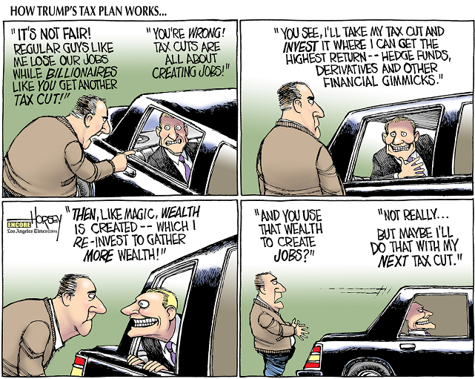
Topic 2: the tax cuts and jobs act of 2018

Slide 21
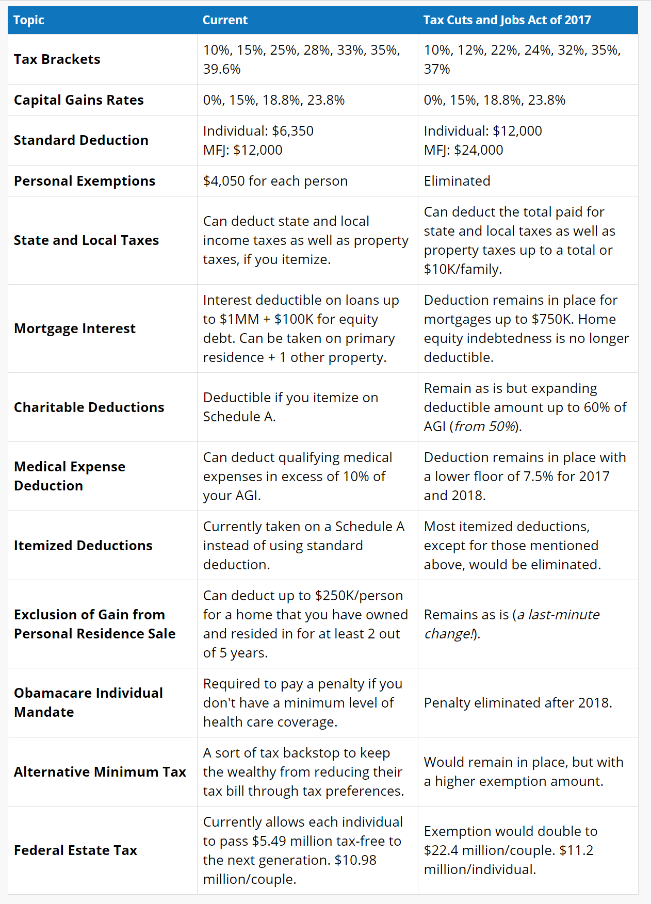
The economics of the new tax law

Slide 22
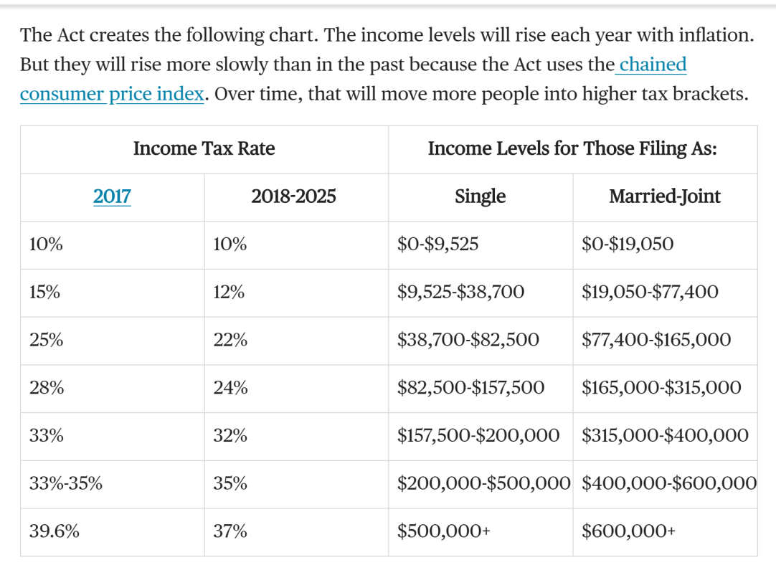
New brackets just in time for April madness!

Slide 23
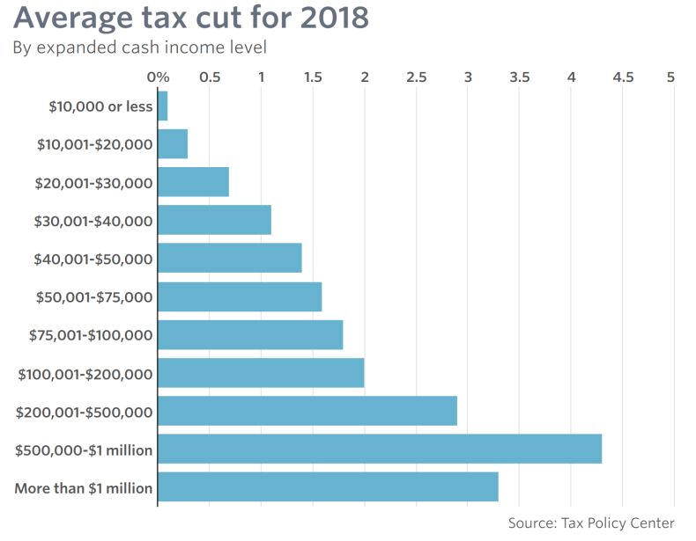
How much will I save?
So, all political cartoons aside, who really does benefit from this tax cut?

Slide 24
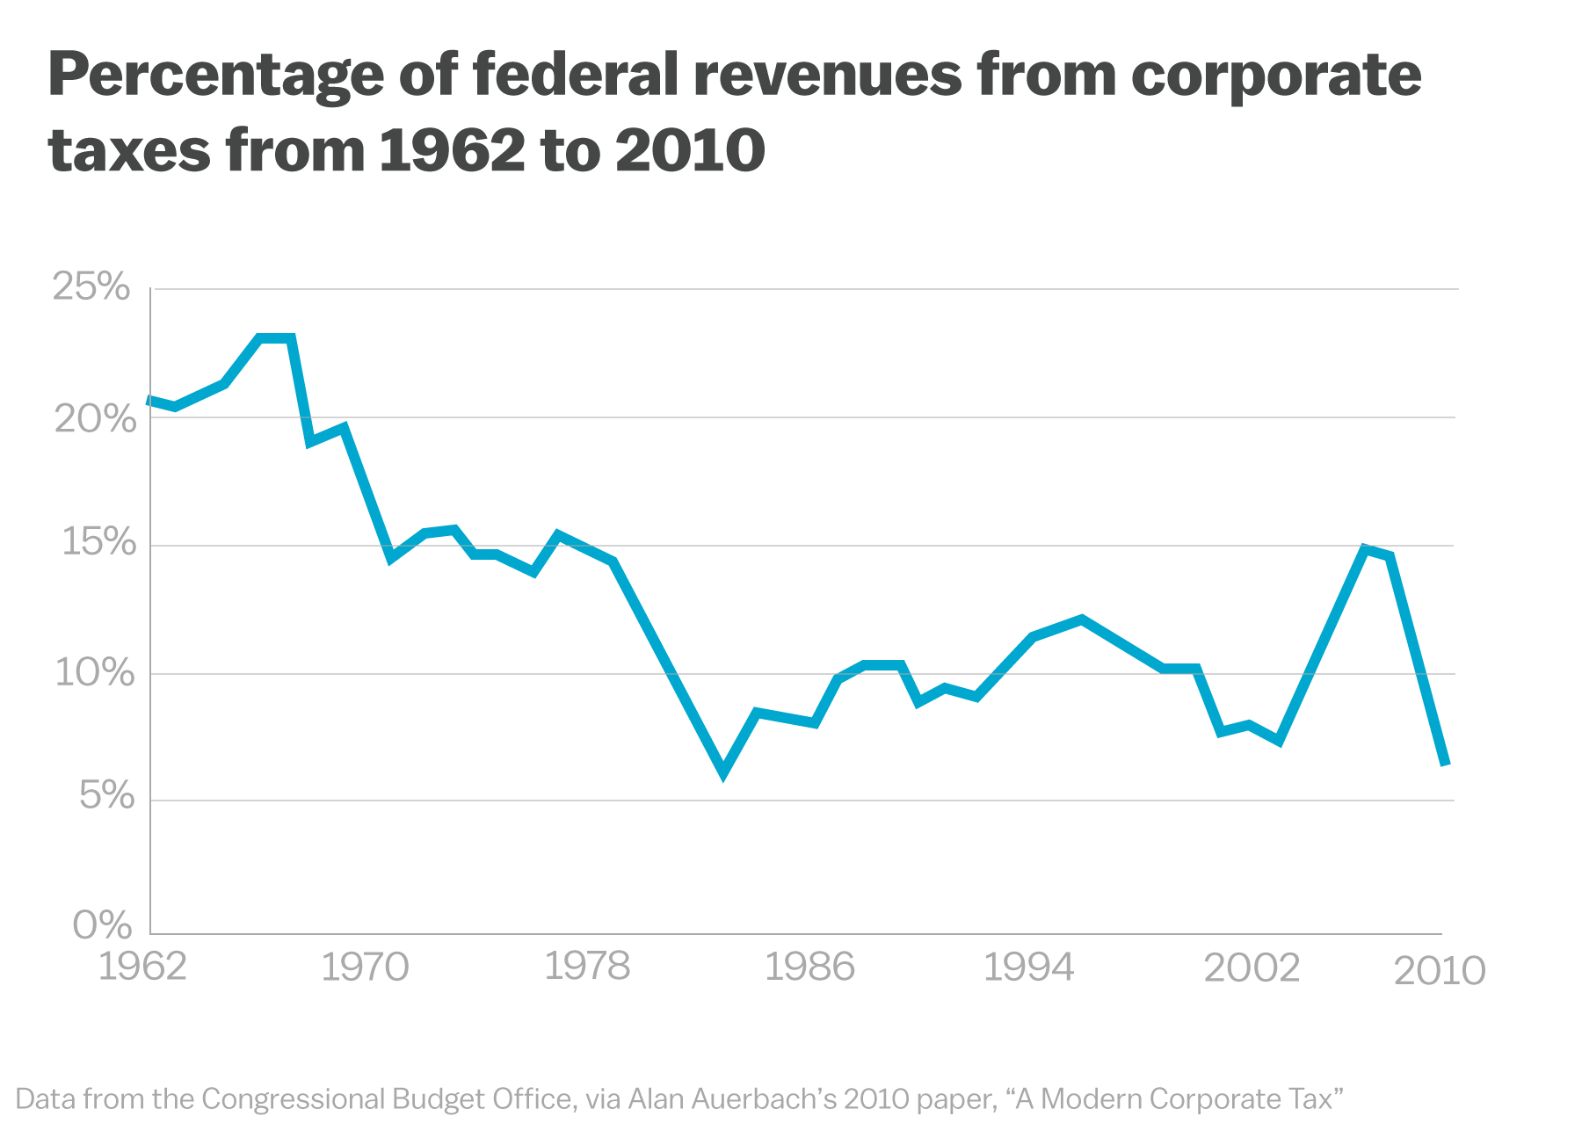
What about revenue?
How does the government balance the loss of revenue from all of those taxes?
… and …
If the percentage of the Federal Government’s revenue (income) is shrinking over time, who is paying for services and the mounting debt?
(Hint: 1.5 Trillion in debt)

Slide 25
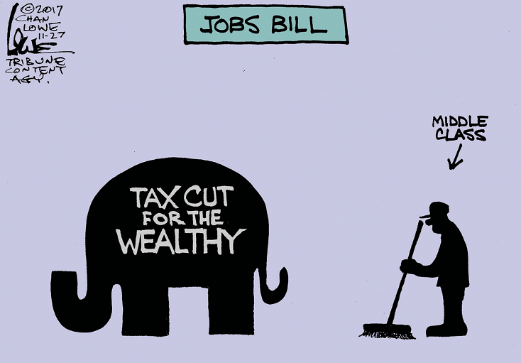
What about jobs to help the economy grow?
Many people fear it looks like this
But it is called the TCJA:
Tax Cuts and Jobs Act.
What about tax cuts helping wealthy business owners tricle down that wealth in the form of expanded production and new jobs?
Will it work?
Will they do it?

Slide 26
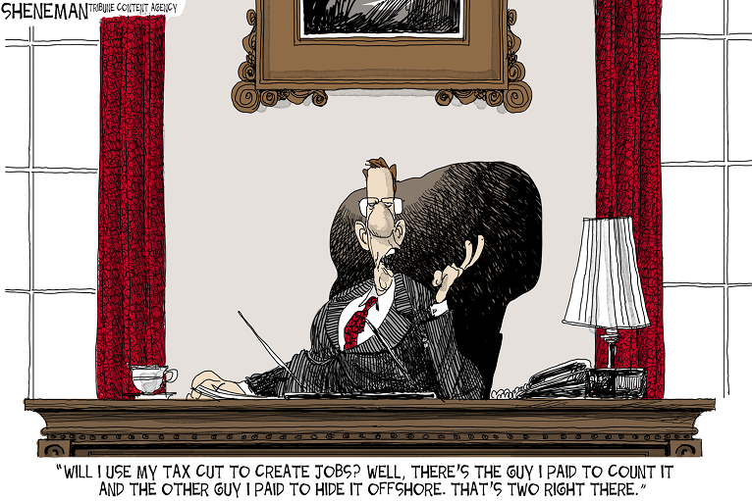
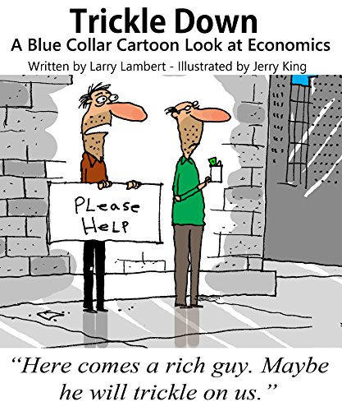
What about revenue?

Slide 27
Does Trickle down economics still work?
Did it ever work?
Let’s ask Dr. Laffer…

Slide 28
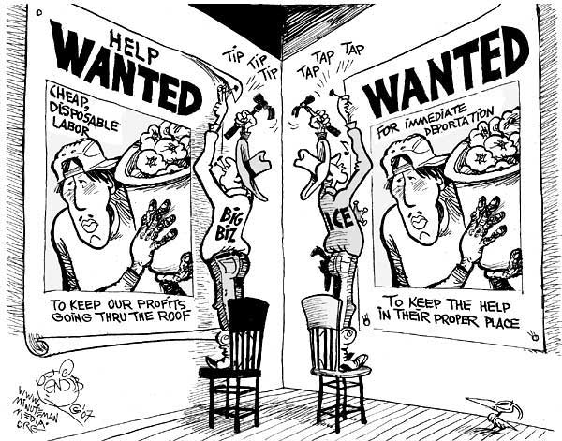
Topic 3: economics of immigration
I.C.E. = Immigration & Customs Enforcement

Slide 29
economics of immigration
Crash Course: Economics of Immigration
Start at 2 minutes

Slide 30
The politics of Immigration
Democrats
Republicans
Want comprehensive reform to give citizenship to people crossing the border
Do not like the idea of someone being “illegal”
However, Obama has deported more illegal aliens than any other President before him
Do not want to award citizenship to people who break the law
Tend to favor mass deportation
However, many corporations would prefer to have a large pool of illegal aliens around
Notes:
What is the transition for the immigration section? Do students think that if we removed cheap labor, technology would be incentified to keep prices down?

Slide 31
economics of immigration
The economics of immigration

Slide 32
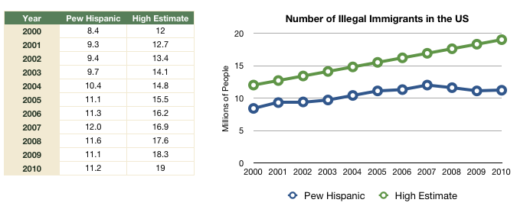
Some Immigration Numbers
Estimates vary, but some believe that as many as 20 million illegal immigrants currently reside in the United States.
Notes:
PERHAPS I CAN FIND MORE CURRENT GRAPHS FROM SOUTHERN POVERTY LAW CENTER OR PEW.

Slide 33
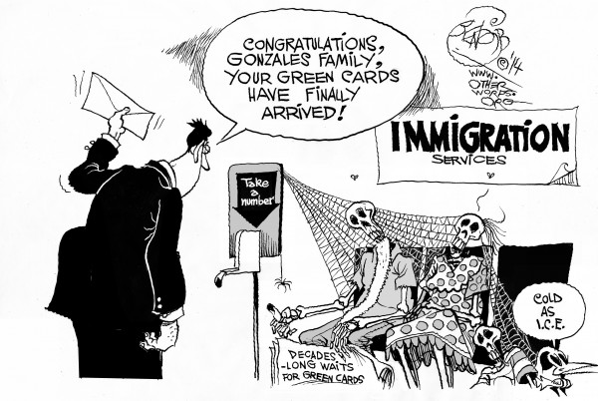
Options for DACA and others?
Deferred Action for Childhood Arrivals (Dreamers)
Why can’t illegal immigrants just “go home and get in line to come back legally?”
Notes:
PERHAPS I CAN FIND MORE CURRENT GRAPHS FROM SOUTHERN POVERTY LAW CENTER OR PEW.

Slide 34
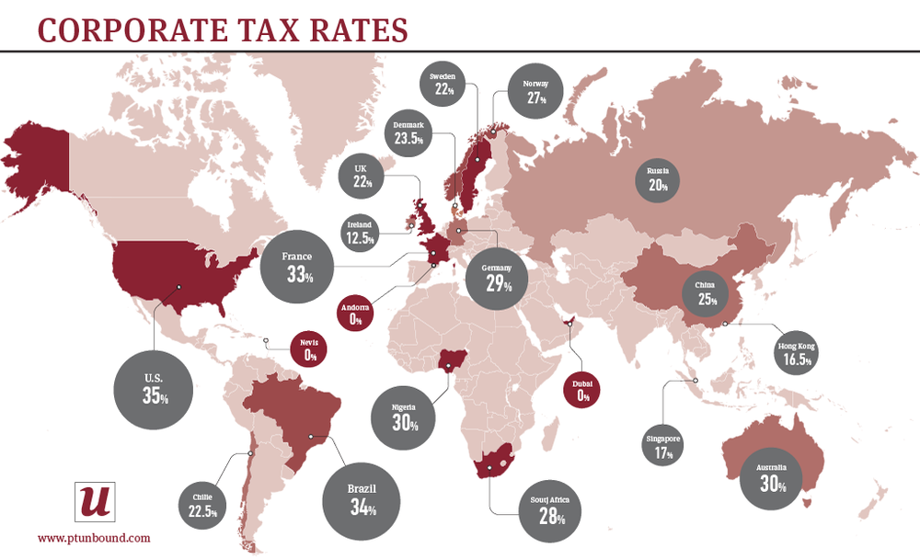
Topic 4: corporate tax inversions
What is a Corporate Tax Inversion?
First, let’s look at Corporate Tax Rates around the world…
But is that really
what U.S. companies pay in Corporate Taxes?
Notes:
PERHAPS I CAN FIND MORE CURRENT GRAPHS FROM SOUTHERN POVERTY LAW CENTER OR PEW.

Slide 35
Corporate tax rates around the world
Actual vs. Effective Corporate Tax Rate
What is the Effective Tax Rate in the U.S.?
CNN Money
Notes:
PERHAPS I CAN FIND MORE CURRENT GRAPHS FROM SOUTHERN POVERTY LAW CENTER OR PEW.

Slide 36
So, what is a corporate inversion?
Corporate Tax Inversion
Notes:
PERHAPS I CAN FIND MORE CURRENT GRAPHS FROM SOUTHERN POVERTY LAW CENTER OR PEW.

Slide 37
Wisconsin corporate inversions?
How about Wisconsin companies?
Milwaukee State Journal Piece
Notes:
PERHAPS I CAN FIND MORE CURRENT GRAPHS FROM SOUTHERN POVERTY LAW CENTER OR PEW.

Slide 38
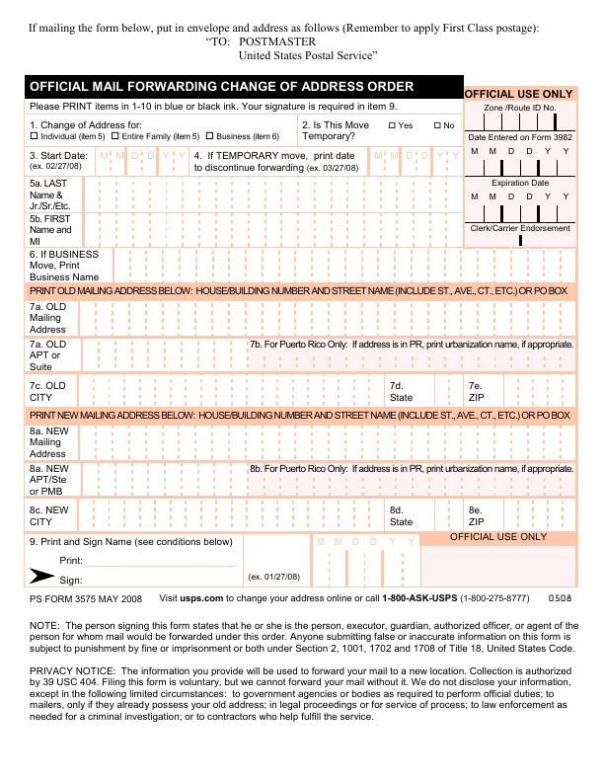
Dear I.R.S., we have moved…
Business
Change of Address Form
United States
Ireland
Notes:
PERHAPS I CAN FIND MORE CURRENT GRAPHS FROM SOUTHERN POVERTY LAW CENTER OR PEW.

Slide 39
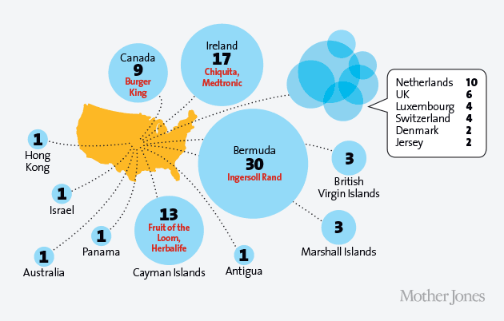
Where do companies move their hq?
Where do companies go to “invert?”
Notes:
PERHAPS I CAN FIND MORE CURRENT GRAPHS FROM SOUTHERN POVERTY LAW CENTER OR PEW.

Slide 40
What do corporate inversions do to federal revenues?
Burger Horton's Donuts Your Way
What is a Territorial Tax Policy…
What is a tax haven?
What does this activity do to the U.S. Government’s revenue and the U.S. Economy?
Notes:
PERHAPS I CAN FIND MORE CURRENT GRAPHS FROM SOUTHERN POVERTY LAW CENTER OR PEW.

Slide 41
Exit Ticket
On a notecard:
Write your name in the top right corner
Write the name of a political issue (not one that we have discussed in class) in the top left corner
On the lines of the notecard, write how the political issue you have identified (in Step #2) relates to economics
Toss the notecard in the red basket on your way out the door
Notes:
I LIKE THE IDEA OF A SUMMARY OR EXIT TICKET. I also want to do an activity, stand by your opinion sign, research and share, or game. Most importantly, we want to get thoughtful discussion going during class.

